Slide 1
UNIT-II
LOGIC FAMILIES

Slide 2
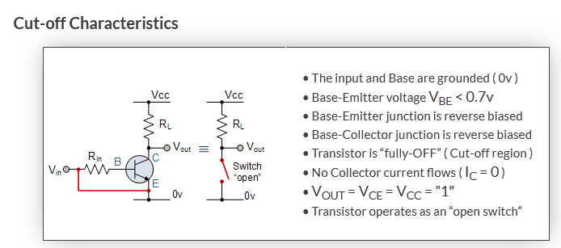
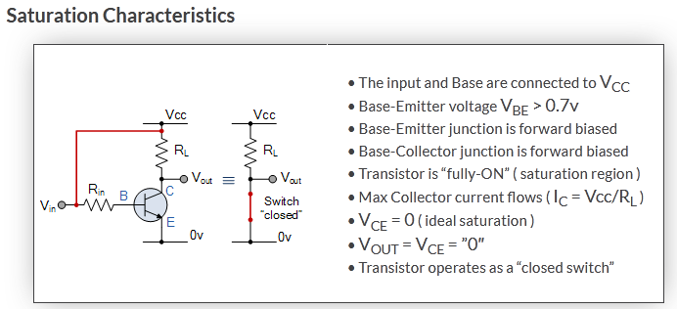
Transistor as a switch

Slide 3
Typical npn Transistor Parameters
Region | V_{BE} (V) | V_{CE} (V) | Current Relation
Cutoff | < 0.7 | Open circuit | I_{B}=I_{C}=0
Active | 0.7-0.8 | > 0.8 | I_{C} =h_{FE}I_{B}
Saturation | 0.8-0.9 | 0.2 | I_{B} ≥I_{C}/h_{FE}
Notes:
3

Slide 4
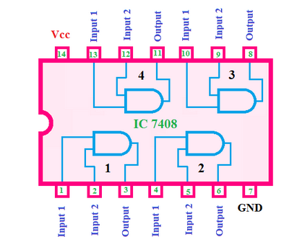
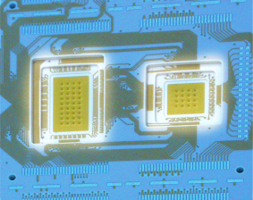
Characteristics of digital Ics Integration Levels
Gate/transistor ratio is roughly 1/10
SSI(Small Scale Integration) < 12 gates/chip
MSI(Medium Scale Integration) < 100 gates/chip
LSI(Large Scale Integration) …1K gates/chip
VLSI(Very Large Scale Integration )…10K gates/chip
ULSI(Ultra Large Scale Integration )…100K gates/chip
GSI(Giant Scale Integration ) …1Meg gates/chip

Slide 5
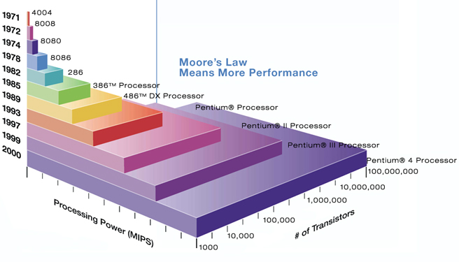
Moore’s law
A prediction made by Moore (a co-founder of Intel) in 1965:
“a number of transistors to double every 2 years.”

Slide 6
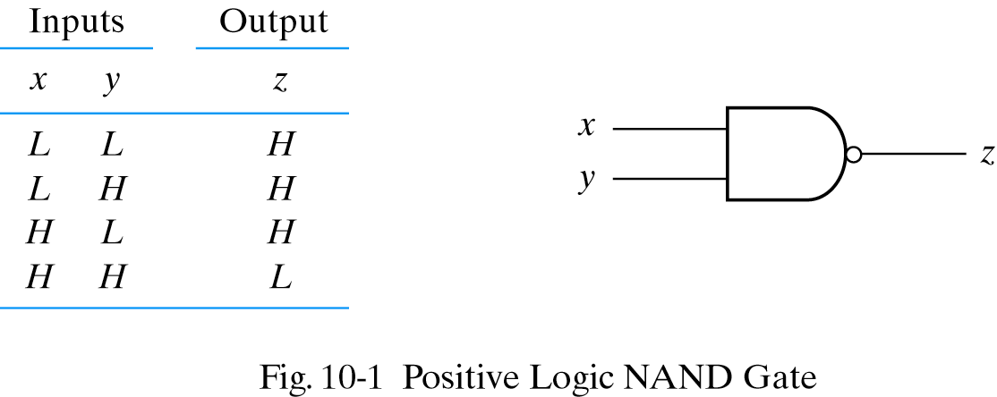
Positive logic
Positive logic: H is set to be binary 1
L is set to be binary 0

Slide 7
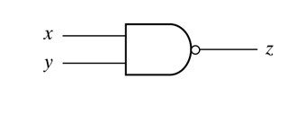
Negative logic
Negative logic: L is set to be binary 1
H is set to be binary 0
INPUT |  | OUTPUT
X | Y | Z
H | H | L
H | L | L
L | H | L
L | L | H

Slide 8
Digital IC specifications (or) characteristics of digital logic families
The most useful specifications or feature to be concerned of IC logic families:
Threshold voltage
Propagation delay
Power dissipation
Fan-in
Fan-out
Voltage and current requirement
Noise Margin
Operating temperature
Speed power product

Slide 9
Digital IC Specifications
Threshold voltage: The voltage at the input of a gate which causes a change in the state of the output from one logic level to the other.
Propagation delay: Time interval b/w the application of an i/p pulse & occurrence of resulting o/p pulse.
The average transition-delay time for the signal to propagate from input to output when the binary signal changes in value.
A pulse through a gate takes a certain amount of time to propagate from input to output. This interval of time is known as the propagation delay of the gate.
Average transition delay time tpd = (tPLH + tPHL) /2

Slide 10
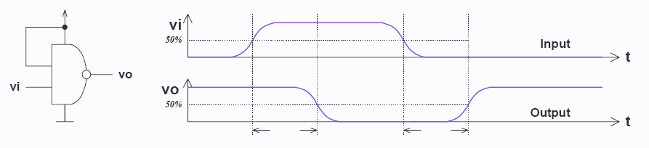
Logic families: propagation delay
T_{PD,HL} – input-to-output propagation delay from HI to LO output
T_{PD,LH} – input-to-output propagation delay from LO to HI output

Slide 11
Power dissipation
Every logic gate draws some current from the supply for its operation
The current drawn in HIGH state is different from that drawn in LOW state.
Power dissipation of a logic gate is the power required by the gate to operate with 50% duty cycle at specified frequency.
The power needed by the gate expressed in mW
Pd=Vcc*Icc(avg)*n. where Vcc is the gate supply voltage, Icc(avg) is the average current drawn from the supply by the entire IC, n is the number of gates in the IC.
Icc(avg) = (ICCH+ICCL)/2
ICCH-current drawn by the IC when all the gates in the IC are in HIGH state,
ICCL-current drawn by the IC when all the gates in the IC are in LOW state,
Total power consumed by an IC is equal to the product of the power dissipated by each gate and the no. of gates in that IC.

Slide 12
Fan-in and Fan-out
Fan-in :The fan-in of a logic gate is defined as the number of inputs that the gate is designed to handle.
Fan-out: The number of standard loads can be connected to the output of the gate without degrading its normal operation. Sometimes the term loading is used
High state fan-out : the fan-out of the gate when its output is logic 1-driving gate sources current
Low state fan-out : the fan-out of the gate when its output is logic 0- driving gate sinks current
Actual fan out is smaller of these two numbers.

Slide 13
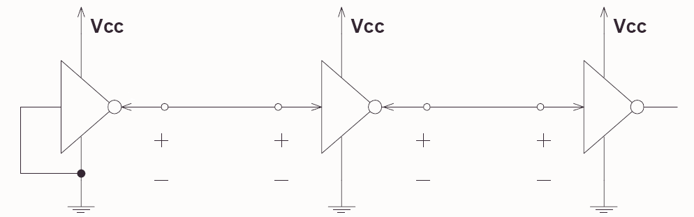
Logic families: Voltage levels
V_{OH}(min) – The minimum voltage level at an output in the logical “1” state under defined load conditions
V_{OL}(max) – The maximum voltage level at an output in the logical “0” state under defined load conditions
V_{IH}(min) – The minimum voltage required at an input to be recognized as “1” logical state
V_{IL}(max) – The maximum voltage required at an input that still will be recognized as “0” logical state

Slide 14
Logic families: current requirements
I_{OH} – Current flowing into an output in the logical “1” state under specified load conditions
I_{OL} – Current flowing into an output in the logical “0” state under specified load conditions
I_{IH} – Current flowing into an input when a specified HI level is applied to that input
I_{IL} – Current flowing into an input when a specified LO level is applied to that input

Slide 15
Noise margin
The unwanted signals are referred to as noise
Noise margin is the maximum noise added to an input signal of a digital circuit that does not cause an undesirable change in the circuit output .
High state noise margin is the difference between the lowest possible high output and the minimum input voltage required for a HIGH.
Low state noise margin is the difference between the largest possible low output and the maximum input voltage required for a LOW.

Slide 16
- operating temperature
The IC gates and other circuits are temperature sensitive.
They are designed to operate satisfactorily over a specified range of temperature.
Range for commercial application is 0֯ to70֯ C, industrial 0֯ to85֯ C and for military applications -55֯ to 125֯ C.
Speed power product
Multiply the gate propagation delay by the gate power dissipation
Smaller value is desirable. The smaller value gives better overall performance.
It has the units of energy and expressed in picco-joules
The IC has an average propagation delay of 10ns and an average power dissipation of 5mw, the speed power product is
10 ns*5mw=5*10^-12 watts-seconds= 5 picco-joules

Slide 17
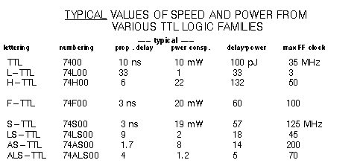
COMPARISON OF LOGIC FAMILIES

